Slide 1

RATE MY COURSE
Colossus 4.0 Team
Goal of the application:
Create a site to let students provide ratings and post comments on the courses that they attend at their University.

Slide 2

User Personas (1/2)
User: Student who wishes to actively participate in the site
Description: Maggie McGeek is a really sweet, but socially awkward, lady that is working hard in
order to get her Masters Degree in Aeronautical Engineering. Maggie finds it that is really easy to communicate by typing in her keyboard instead of getting in actual touch with people. This kind of behaviour makes her really active in the world of Internet and Social Media, where of course Maggie’ s profile picture is a cat, as she tries to protect her privacy. In the context of our site, Maggie is really glad that she has the chance to rate the courses that she attended, give her feedback, and enlighten other students that try to find more about the offered courses. Although, Maggie is quite frustrated by the fact that one of her electives was not included in the list with the available courses, that’s why she is pestering the admin with her daily messages where she is demanding to learn more about the progress that is done while the course is added to the site.
Name: Maggie McGeek
Age: 22
Hobbies: Problem Solving, Reading romantic novels
Occupation: MSc Student
Critical needs: Basically, everything that is available will be utilised by Maggie.
Opportunities to improve user experience: Maybe allowing more characters in the comments
section. Perhaps Maggie’s input in the further additions to the site will prove invaluable.

Slide 3
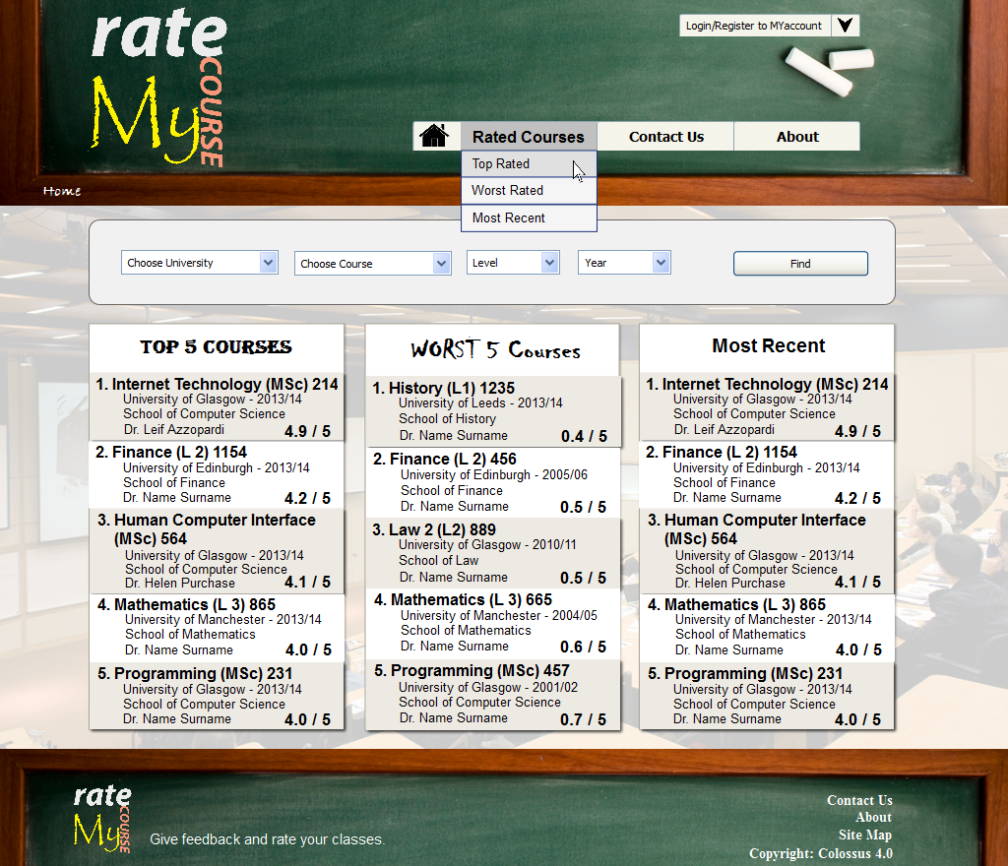
Wireframes (1/3)
1
2
login/register
logo
menu bar
header
3
4
4. path
5
5. navigation feature
6
7
8
top rated courses list
worst rated courses list
most recently rated courses
body
9
9. quick links
footer

Slide 4
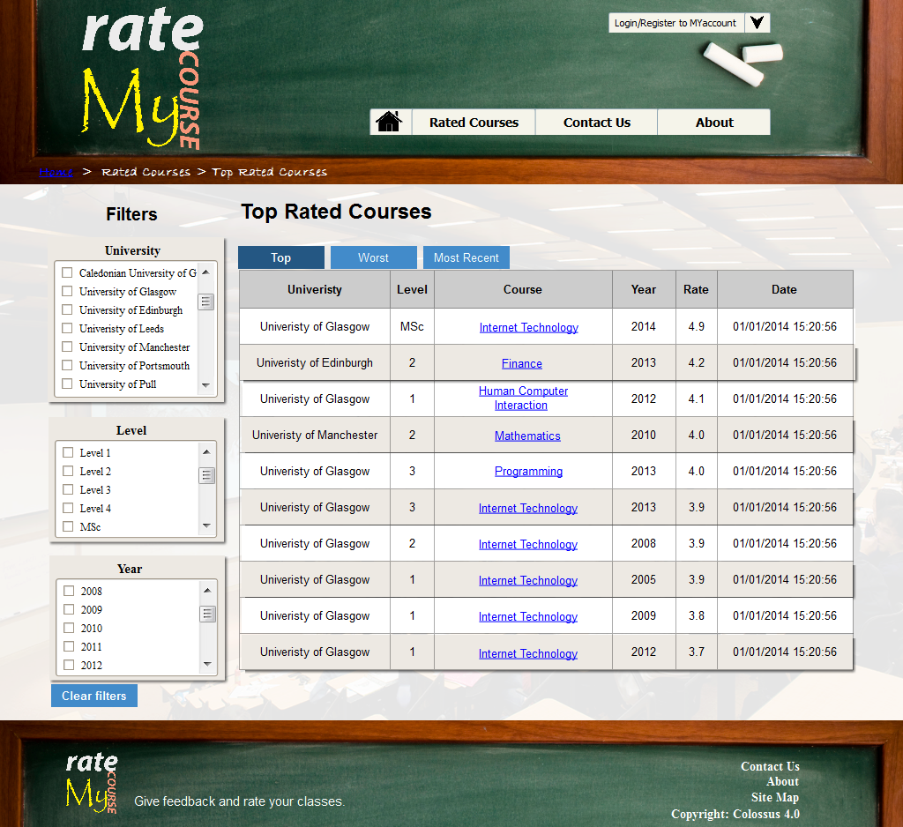
Wireframes (2/3)
1
2
filters for refining the results
sorting buttons
results table
3

Slide 5
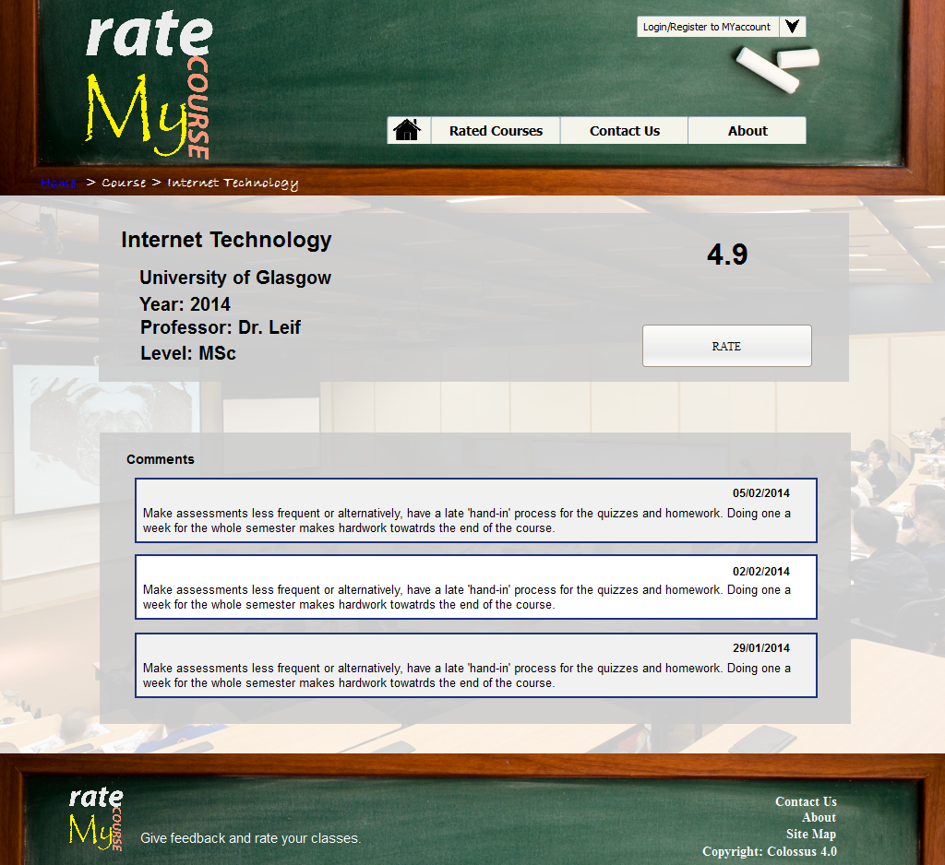
Wireframes (3/3)
1
2
course details
average course rating
3
3. button to rate this course
4
4. posted comments

Slide 6
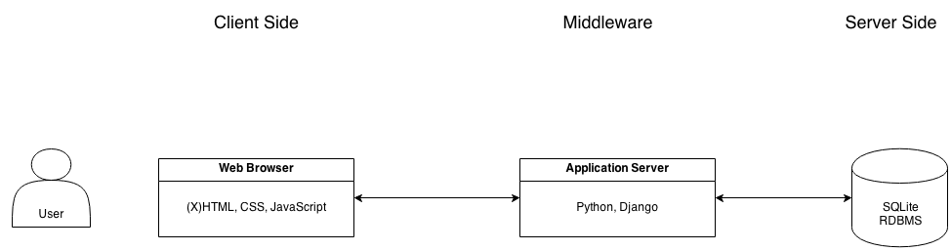
3-Tier Architecture Diagram

Slide 7
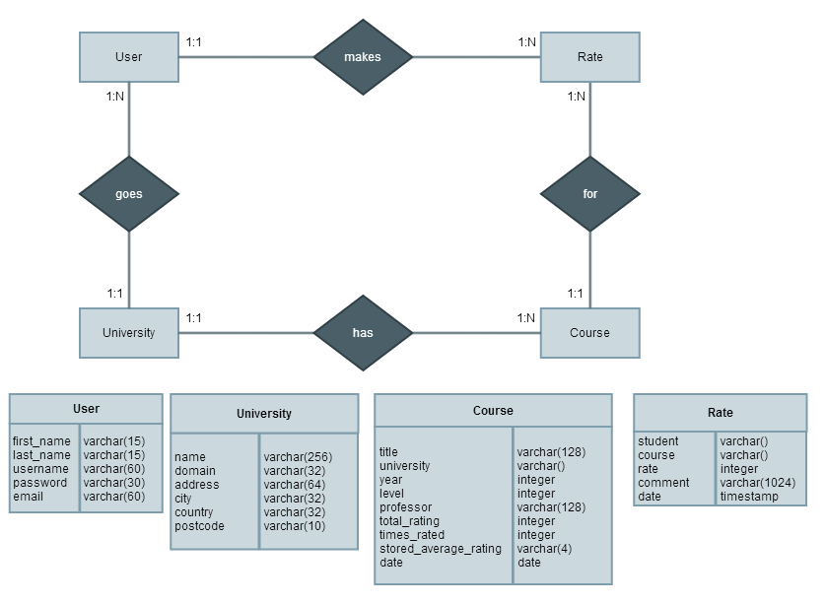
Entity-Relationship Diagram

Slide 8
Stand Out Features/Functionality
The ratings are close to reality, because only users that provide a verified university e- mail address are allowed to register and eventually rate a course.
The ratings are posted anonymously and the users do not feel that they are in threatened if they provide negative feedback.
The Rate My Course application provides a friendly and easy to understand user interface.
The feature for finding a course is quite simple and really efficient.
The process of rating a course is quite clear and straightforward.

Slide 9

Colossus 4.0 Team
Thank you!
Constantinos Charalambous, 2109194C Ektor Pavlos Paradeisis, 2107742P Marios Fantaoutsakis, 2097434F Pantelis Georgiades, 2103567G Paraskevas Sarris, 2111156S
Question
s?

Slide 10

User Personas (2/2)
User: Student who wishes to find “easy” courses.
Description: Charlie Cheaterson is in his late teens/early 20s. Charlie is enjoying his life in the university and he can be easily described as a party animal. After a couple of semesters he finds that it is a bit difficult to juggle with an academic life and “extracurricular activities”. Charlie would not necessarily rate/comment a course. He would rather dedicate his time in creating a spreadsheet with other users’ feedback and developing a strategy to get the most by putting the least effort.
Critical needs: Charlie would really appreciate it if there was an efficient navigation function that would filter his university's courses, allow him to skim through their comments, and find subjects that contain phrases like “easy peasy”,“easily gained credits”, or “like taking a walk in the park”.
Opportunities to improve user experience: Make the site usable, make the search function return relevant results.
Name: Charlie Cheaterson
Age: 19
Hobbies: Partying, Rugby
Occupation: BSc Student

Slide 11
Specification List
(MoSCoW Prioritization Technique)
M – MUST have this
The site should allow only it’s registered/logged in users to rate their university courses.
The site should allow only it’s registered/logged in users to add comments about their university courses. A student will be registered once it is proven that his/her email comes from a valid university domain.
The administrator would be able to add different universities and their respective email domains.
S – SHOULD have this if at all possible
The site should allow its registered users and its visitors to find a course and have full access to its comments and ratings. The site should let everyone see a list of the most recently rated courses.
The site should let everyone see a list of the best/worst rated courses.
The front page should present the most recently rated courses alongside the top/worst five course ratings. The front page should provide some form of navigation to courses.
Students may contact the administrator and recommend the addition of courses to the system.

Slide 12
Specification List
(MoSCoW Prioritization Technique)
C – COULD have this if it does not affect anything else
Visitors of the site that come from a university that is not included in the existing list of universities could contact the administrator and request the addition of their university’s domain.
–The site will provide a contact page.
W – WON’T have this time but WOULD like in the future
The site will allow it’s users to share their ratings/comments to social networks.
The site will offer a personalized view of the first page after a user is logged –in.
- i.e. the top, worst and most recently rated courses will be from the user’s university.
The site will let it’s users to “like” or “dislike” comments.
The site will let it’s users to comment or reply at other users’ comments.
The site will provide the ability to search into the posted comments.
The site will provide a support page.

Slide 13
User needs matrix
Needs For Our User Personas | Rate Courses | Comment Courses | View Courses | View Comments | Navigation Feature | Contact the Admin
Maggie McGeek | ✓ | ✓ | ✓ | ✓ | ✓ | ✓
Charlie Cheaterson |  |  | ✓ | ✓ | ✓

Slide 14
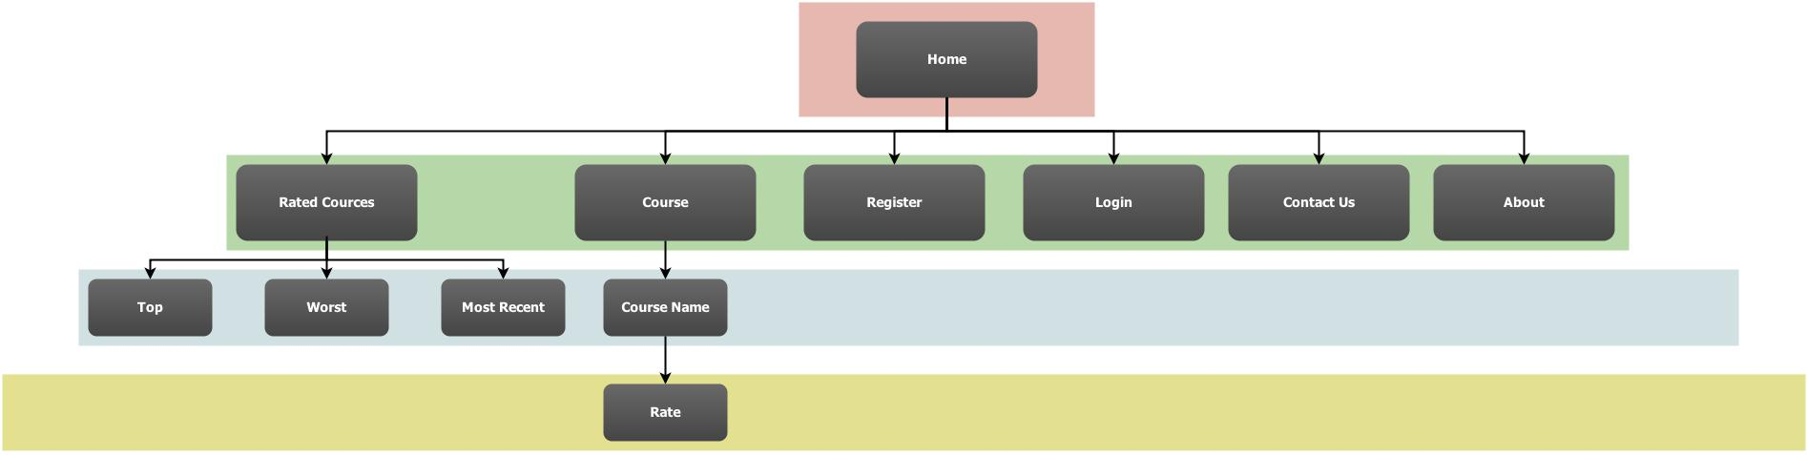
Site map

Slide 15
URLs
Home page:
Top rated courses: Worst rated courses:
Most recent rated Courses: Each course details:
Rate a course form: About the application: Contact form:
www.ratemycourse.co.uk
www.ratemycourse.co.uk/rated_courses/top
www.ratemycourse.co.uk/rated_courses/worst
www.ratemycourse.co.uk/rated_courses/latest
www.ratemycourse.co.uk/course/COURSE_NAME
www.ratemycourse.co.uk/course/COURSE_NAME/rateIt
www.ratemycourse.co.uk/about
www.ratemycourse.co.uk/contact

